Slide 1
Setshabelo Admission System
System Architecture and Design - Presentation
Group 0: Secret Design | Phase 2.0 | 02 October2026

Slide 2
What We'll Cover
OVERVIEW
01
Project Overview
Problem statement, purpose, aim, objectives and scope boundaries.
02
System Architecture
03
UML Diagrams
04
Entity Relational Diagrams
05
UX/UI Design
06
Evidence
Setshabelo Admission System | SRS Presentation
2

Slide 3
SECTION 01
Project Overview
Why this project exists, what it aims to achieve, and its boundaries.
3

Slide 4
Introduction & Document Purpose
INTRODUCTION
• Purpose: This document describes Setshabelo Admission System - what the system will do, and the constraints it will operate under.
• Audience: Written for both the school (stakeholders) and the development team, so both share one source of information.
• Scope of this document: A shortened, presentation-ready walkthrough of the full SRS - requirements, feasibility findings, risk register, and SWOT Analysis.
Setshabelo Admission System | SRS Presentation
4

Slide 5
Problem Statement
THE CHALLENGE
• Manual, onsite registration: Parents must travel to Setshabelo Primary School at the start of each year to apply in person and on paper.
• Error-prone paperwork: Hand-filled forms often result in missing information or wrongly filled documents.
• Long queues, heavy admin load: Parents wait in long physical lines and admin staff must process large batches of paper at once.
• Unreliable communication: The school relies on social media for updates and outcomes, but not every parent has reliable access.
Setshabelo Admission System | SRS Presentation
5
Notes:
Setshabelo Primary School currently uses onsite registrations. This affects parents (long queues) and admin staff (bulk paper processing). The school needs a more streamlined, organised method of receiving applications, and a communication channel that doesn't exclude parents without social media access.

Slide 6
Purpose, Aim & Objectives
VISION
• Purpose: Simplify the application process for new learners, keep parents and learners updated, and publish school achievements to attract new learners.
• Aim: Digitalize the application process and make school updates easily accessible to everyone.
• In short: Replace queues and paper with accounts, forms, and dashboards for both parents and school administrators.
Setshabelo Admission System | SRS Presentation
6
Notes:
The purpose of the prototype is to simplify the application process for new learners, the updates sent to parents/learners, and publishing achievements as advertising. Simplification includes digitalising the application process and making updates easily accessible.

Slide 7
Project Scope
SCOPE DEFINITION
Objectives
Deliverable & Acceptance
• Parents can create and view applications for their children, and access school updates
• Admins can accept and reject applications
• Admins can publish school updates and achievements
• All users can view school achievements
• Deliverable: an integrated Flutter (mobile) + ASP.NET (web) application
• Acceptance criteria: Flutter and ASP.NET share the same backend
• Acceptance criteria: users can perform the same actions on mobile and web
Setshabelo Admission System | SRS Presentation
7
Notes:
Project title: Setshabelo Connect. Aim: develop an integrated prototype for creating and managing learner applications and school updates.

Slide 8
System Architecture
SECTION 02
Main System Components and how they interact with each other.
10

Slide 9
Who uses the system
Setshabelo needs a digital admission process: parents apply for their child from a phone, and the school reviews and decides on applications from the web.
Parent / Guardian
Administrator
Flutter mobile application
ASP.NET web application
Creates an account and logs in with a User ID
Submits a learner application with documents
Tracks or cancels the application
Views school updates and achievements
School admin and admission committee
Logs in with an Admin ID
Reviews applications, then accepts or rejects
Publishes school updates and achievements
Setshabelo Admission System | SRS Presentation
12
Notes:
Product Perspective: the prototype operates as one integrated system. Supabase is the shared backend for both ASP.NET and Flutter, handling logic, data storage, accounts and security. Flutter (MVVM) builds the mobile app, ASP.NET (MVC) builds the web app. A parent's account and application data created on one platform is immediately visible on the other. Admins log in on the web app, review applications, and can accept them, place them under review, or leave a comment visible to the parent.

Slide 10
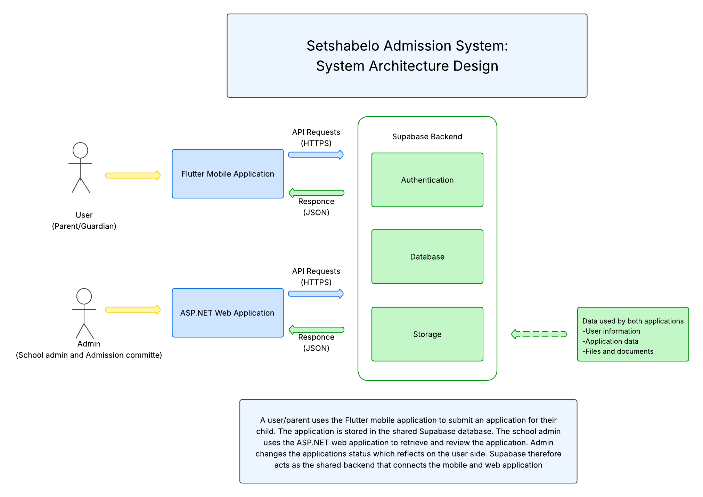
Setshabelo Admission System | SRS Presentation
11

Slide 11
SECTION 03
UML Diagrams
13

Slide 12
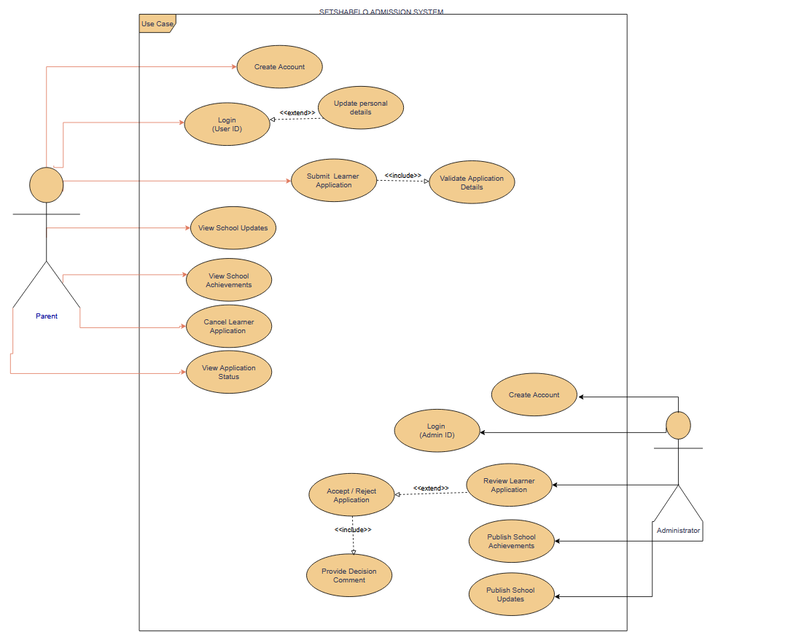
Use Case
Setshabelo Admission System | Phase 2 Presentation
14

Slide 13
04 · UML · RELATIONSHIPS
How the use cases relate
Associations
«include»
«extend»
11
2
1
actor links
always required
conditional
Parent performs 7 use cases (account, login, profile, submit, cancel, updates, achievements). Administrator performs 4 (account, login, review, publish).
Submit Learner Application always runs Validate Application Details, so incomplete forms or missing documents are caught before saving.
Accept / Reject Application extends Review Learner Application; it only occurs when the admin reaches a decision on the application.
Setshabelo Admission System · Secret Design · ITC327W Phase 2
7
Notes:
Include means the included behaviour always happens as part of the base use case. Extend means the extra behaviour only happens under a condition.

Slide 14
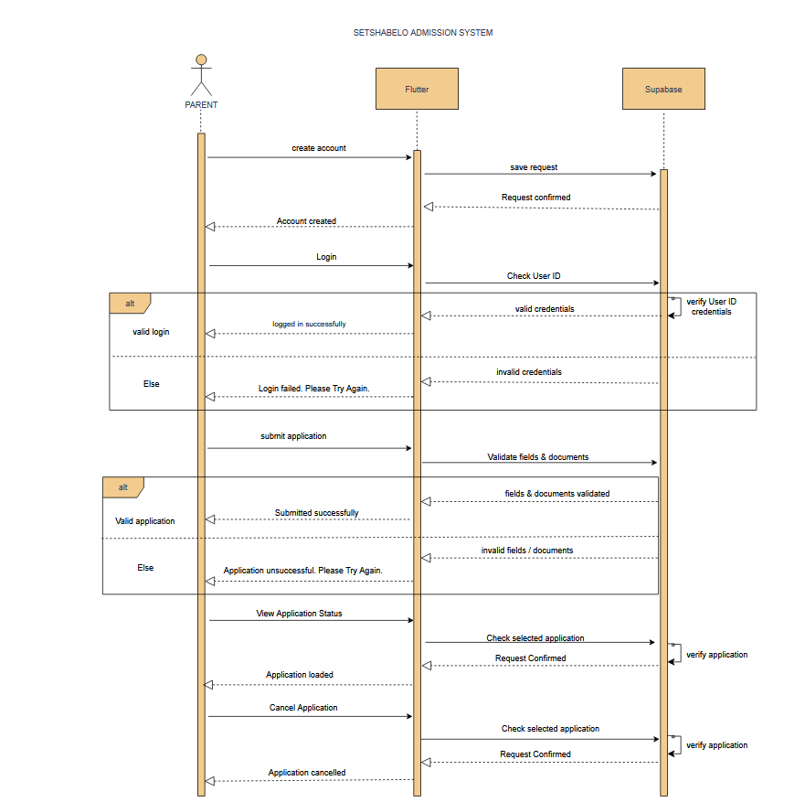
Sequence Diagrams
Admission System | Phase 2 Presentation
15

Slide 15
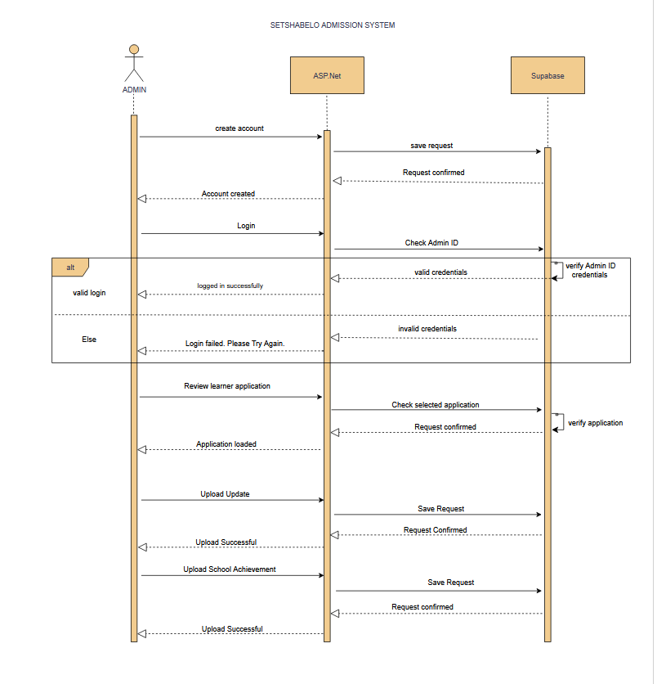
Sequence Diagrams
Setshabelo Admission System | Phase 2 Presentation
16

Slide 16
SECTION 04
Entity Relational Diagram
17

Slide 17
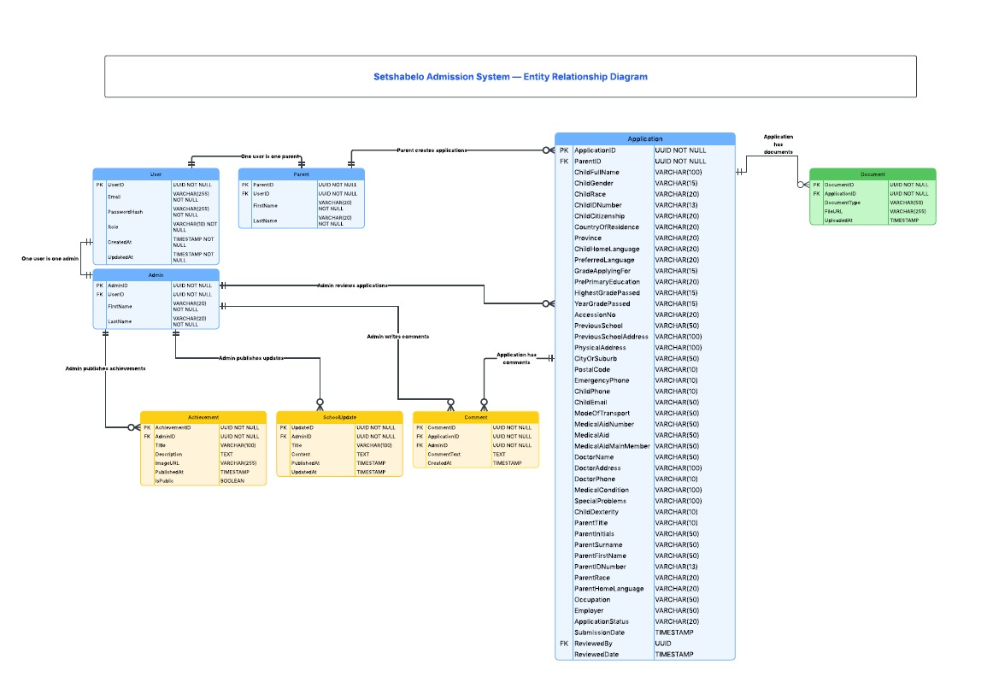
Setshabelo Admission System | Phase 2 Presentation
18

Slide 18
SECTION 05
UX/UI Design
21

Slide 19
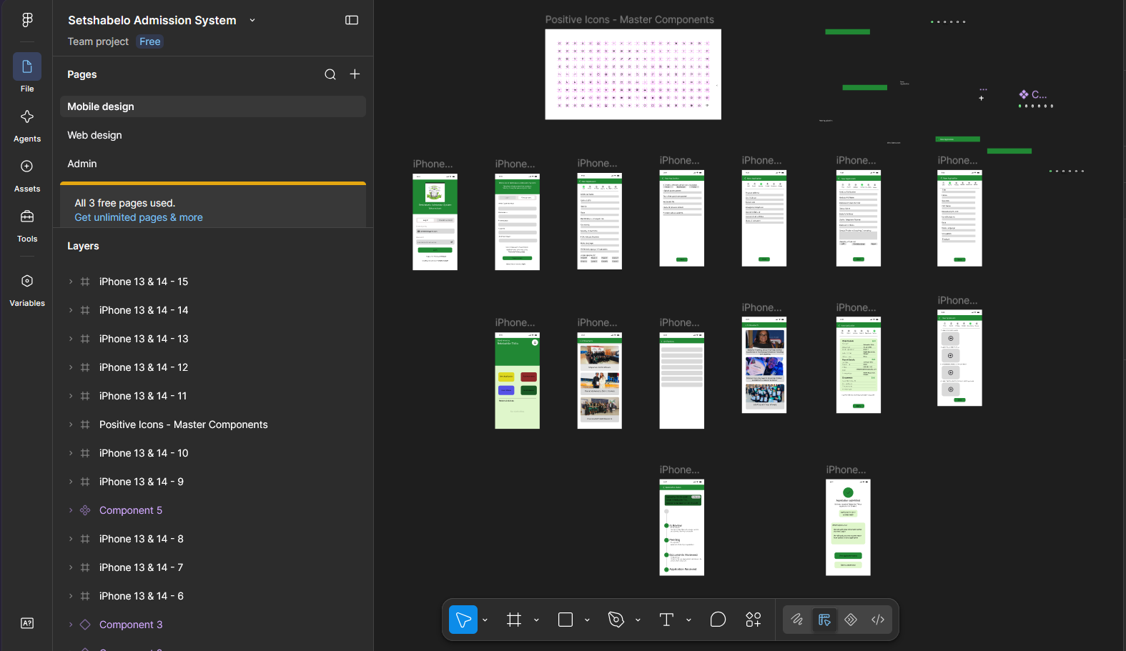
Flutter Application
https://www.figma.com/proto/DtQKcA5cbFv7hiG46obRGQ/Setshabelo-Admission-System?node-id=2-3&p=f&t=Gs5yKR4SaZWXt9bd-0&scaling=scale-down&content-scaling=fixed&page-id=0%3A1&starting-point-node-id=2%3A3
Setshabelo Admission System | Phase 2 Presentation
22

Slide 20
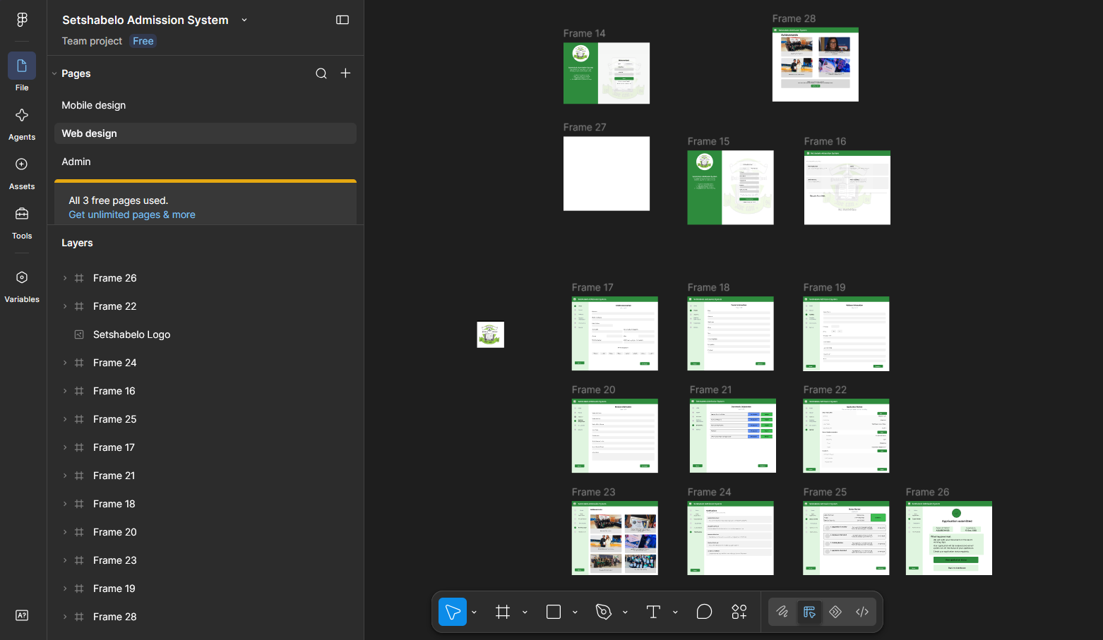
ASP.NET Application
https://www.figma.com/proto/DtQKcA5cbFv7hiG46obRGQ/Setshabelo-Admission-System?node-id=307-1244&p=f&t=u551uaPYP606NPV4-0&scaling=scale-down&content-scaling=fixed&page-id=22%3A319&starting-point-node-id=307%3A1244
Setshabelo Admission System | Phase 2 Presentation
23

Slide 21
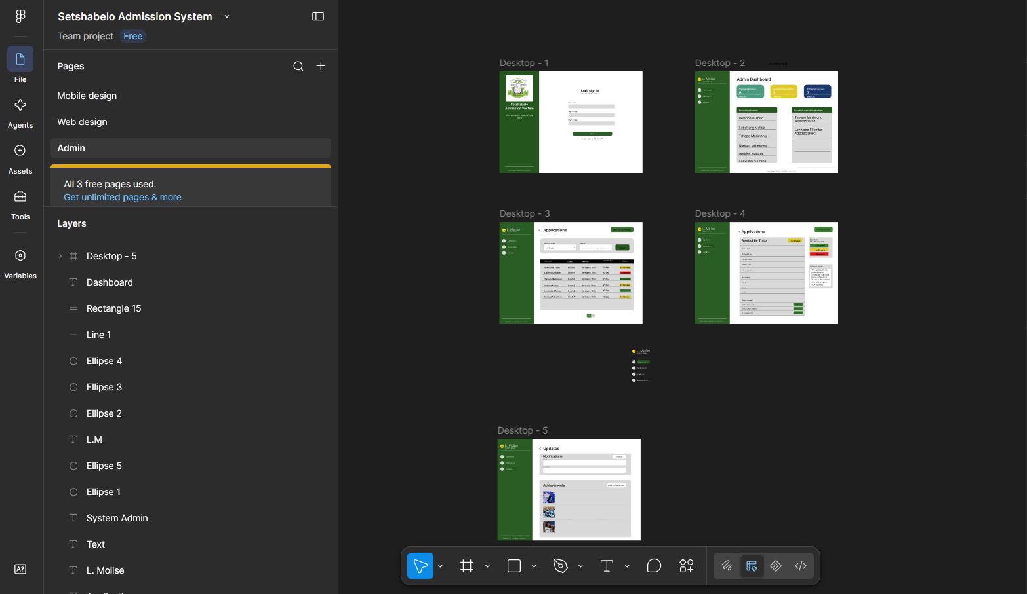
ASP.NET Application: Admin
https://www.figma.com/proto/DtQKcA5cbFv7hiG46obRGQ/Setshabelo-Admission-System?node-id=101-1243&p=f&t=P6thFviGmJ0minRB-0&scaling=min-zoom&content-scaling=fixed&page-id=101%3A1242&starting-point-node-id=101%3A1243
Setshabelo Admission System | Phase 2 Presentation
24

Slide 22
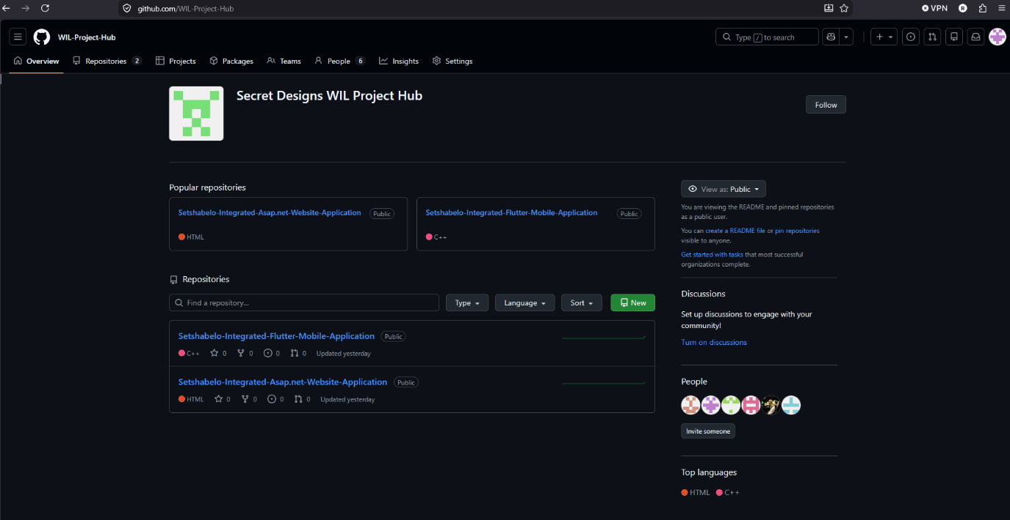
Project Evidence
Strategic Tools - GitHub
Setshabelo Admission System | Phase 2 Presentation
25

Slide 23
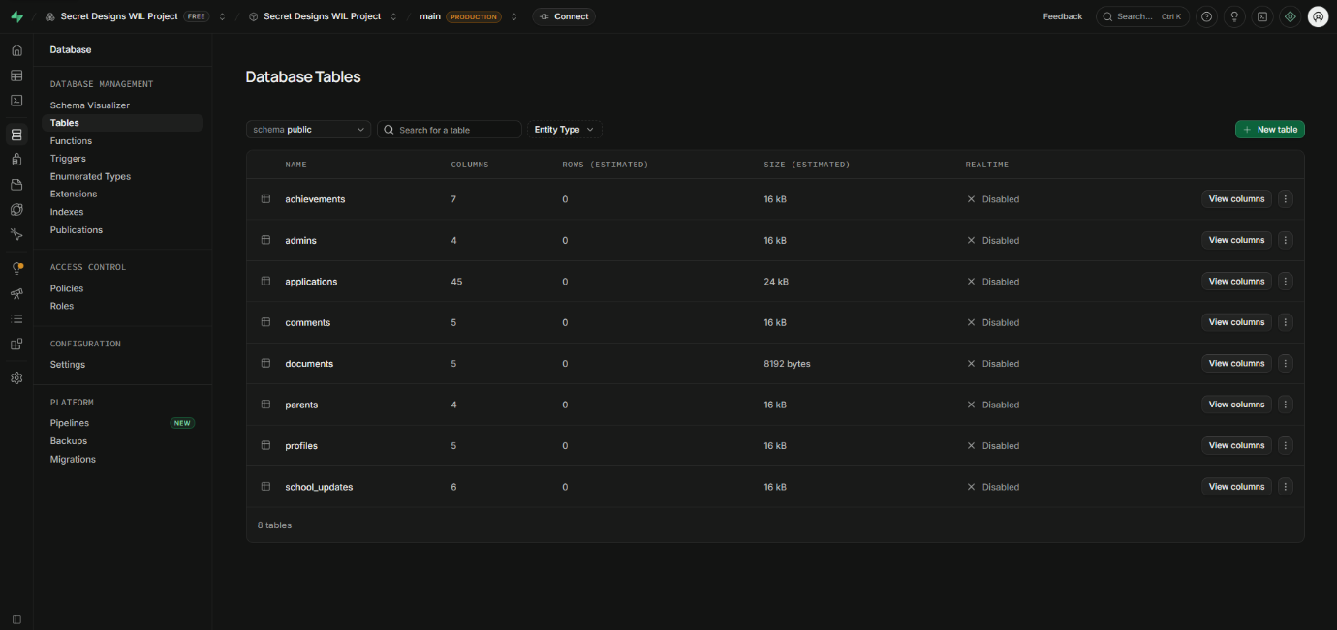
Project Evidence
Strategic Tools - Supabase
Setshabelo Admission System | Phase 2 Presentation
25

Slide 24
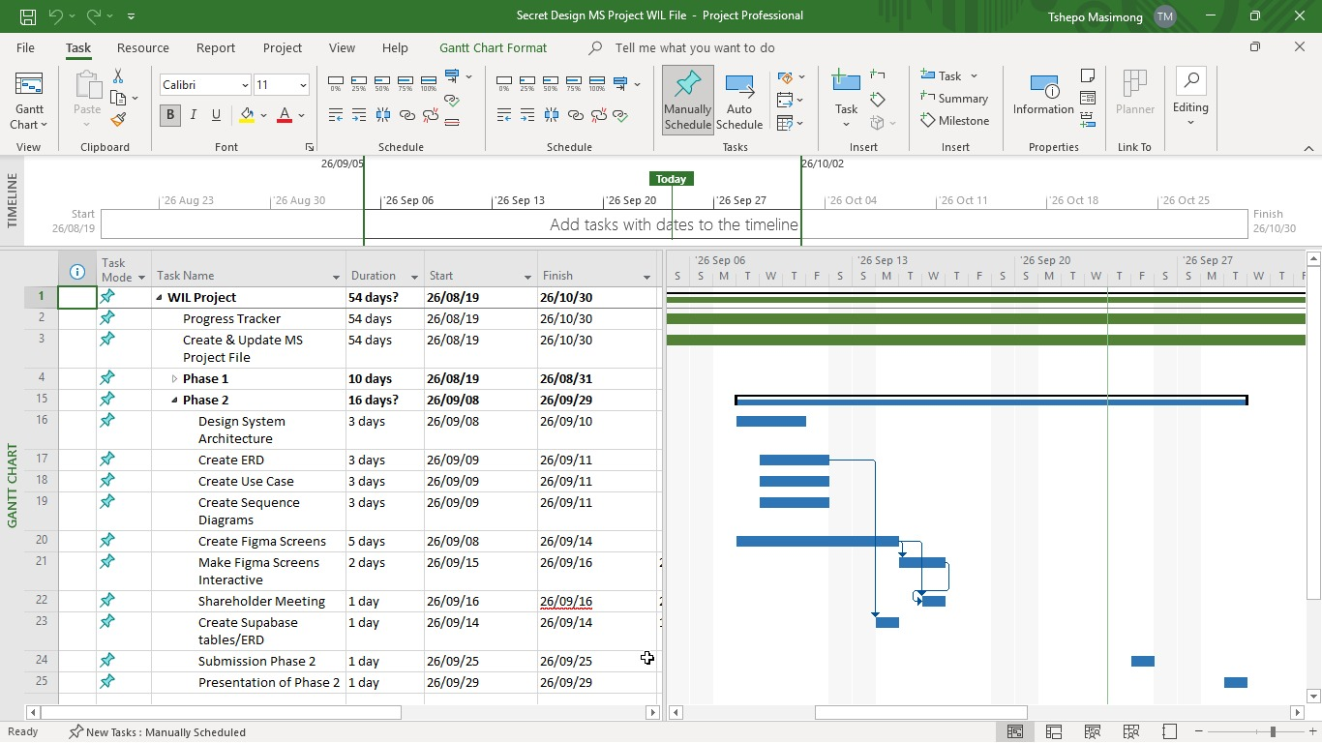
Project Evidence
Strategic Tools – Microsoft Project
Setshabelo Admission System | Phase 2 Presentation
25

Slide 25
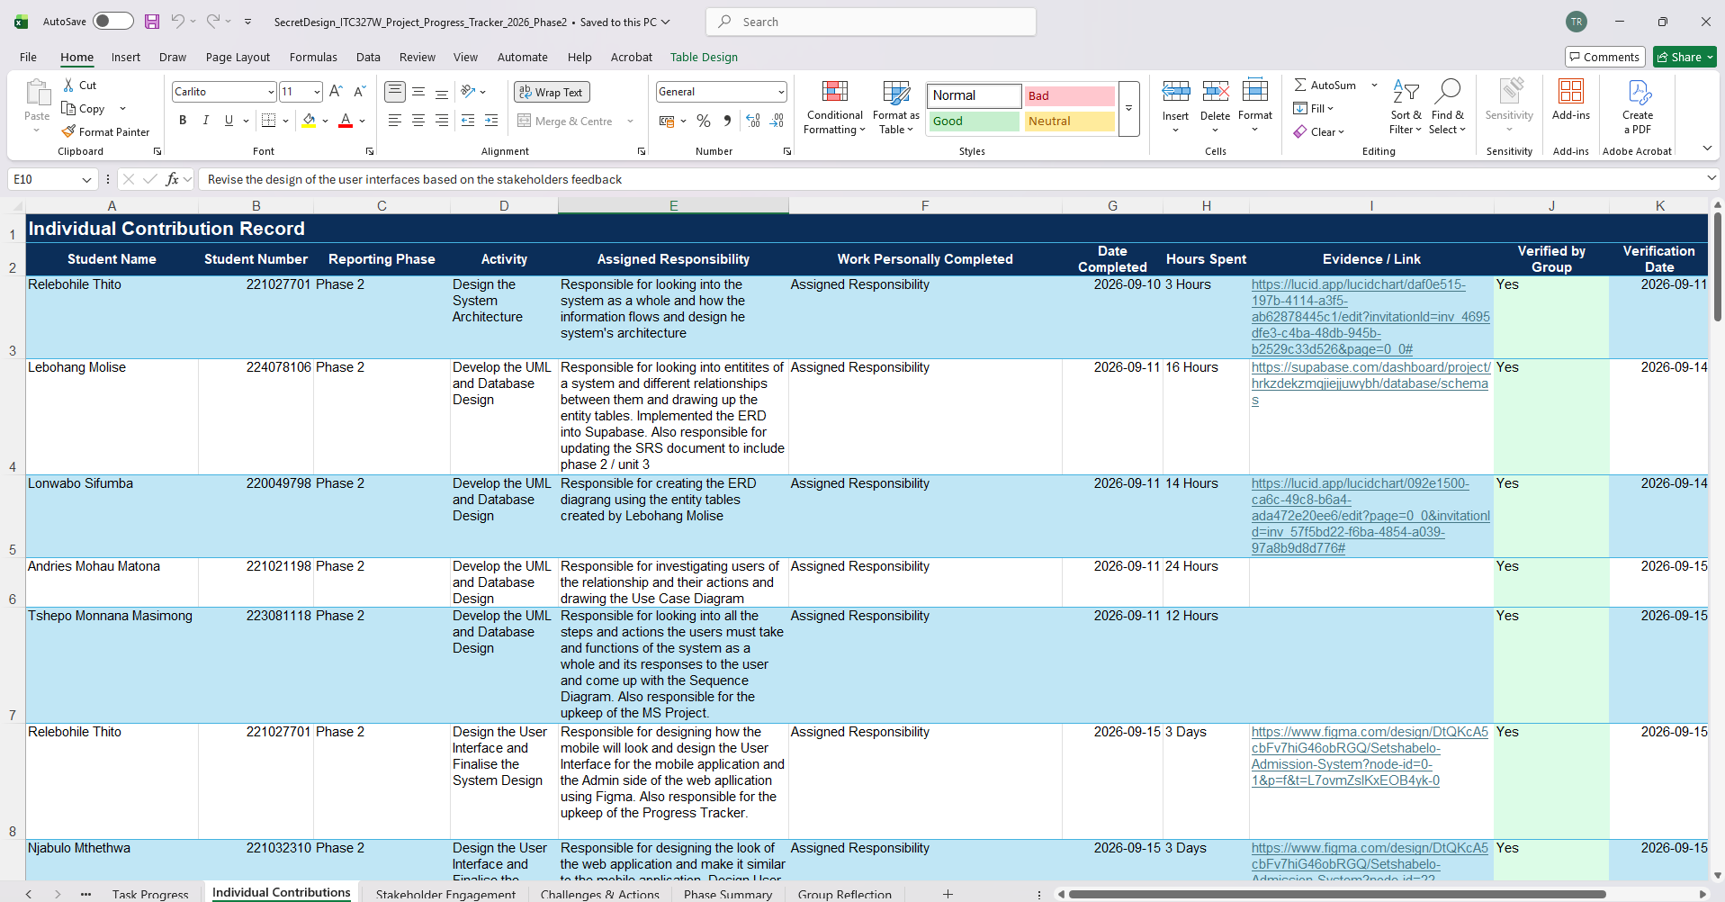
Project Evidence
Strategic Tools – Microsoft Project

Slide 26
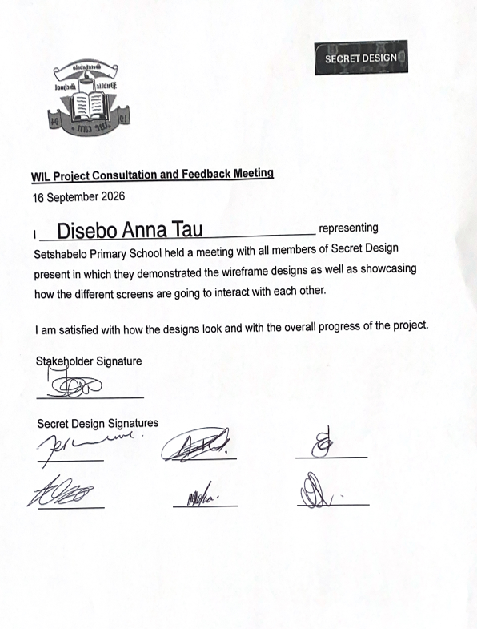
Project Evidence
Design Confirmation Letter

Slide 27
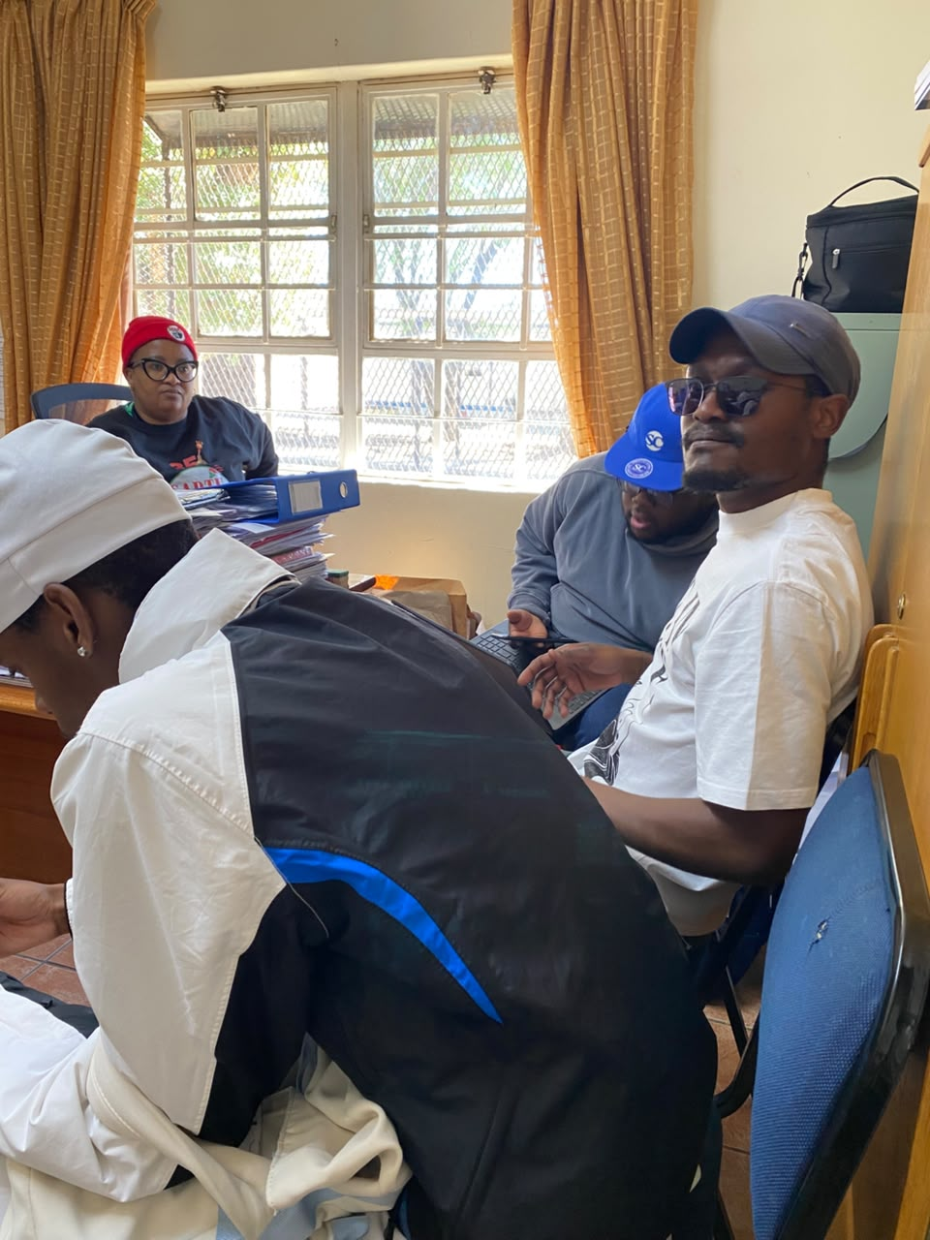
Project Evidence
Stakeholder Meeting

Slide 28
Thank You
Questions & Discussion
GROUP 0 · SECRET DESIGN
Relebohile Thito
Lebohang Molise
Tshepo M Masimong
Lonwabo Sifumba
Andries M Matona
Njabulo R.A Mthethwa
PROJECT EVIDENCE
GitHub: https://github.com/WIL-Project-Hub
Supabase project (backend): https://supabase.com/dashboard/project/hrkzdekzmqjiejjuwybh
Signed project charter & WIL sponsor letter
Meeting notes & diagrams on file

